Slide 1

Console application Presentaion
Jimmy Malandris-Tyler Shanu-Wilson
This Photo by Unknown Author is licensed under CC BY-SA

Slide 2
Aims of application
Input and store student details
Input and store course details
Enrol students from data on a text file
This Photo by Unknown Author is licensed under CC BY-SA

Slide 3
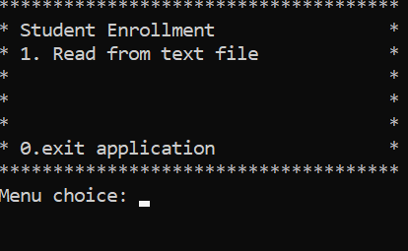
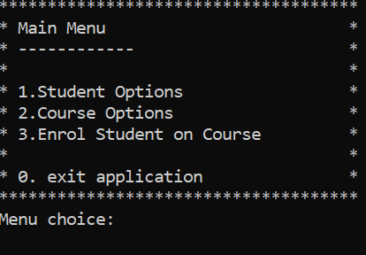
User interface
Text based user interface
Navigate by entering numbers to call different functions
Main menu links to other menus
Student menu- add and view student details
Course menu- add and view course details
Enrol student menu- reads data from a text file that can be viewed

Slide 4

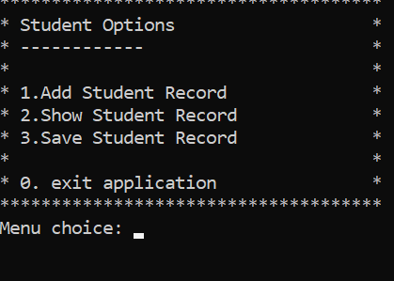

Student menu
Add student details
View student details

Slide 5
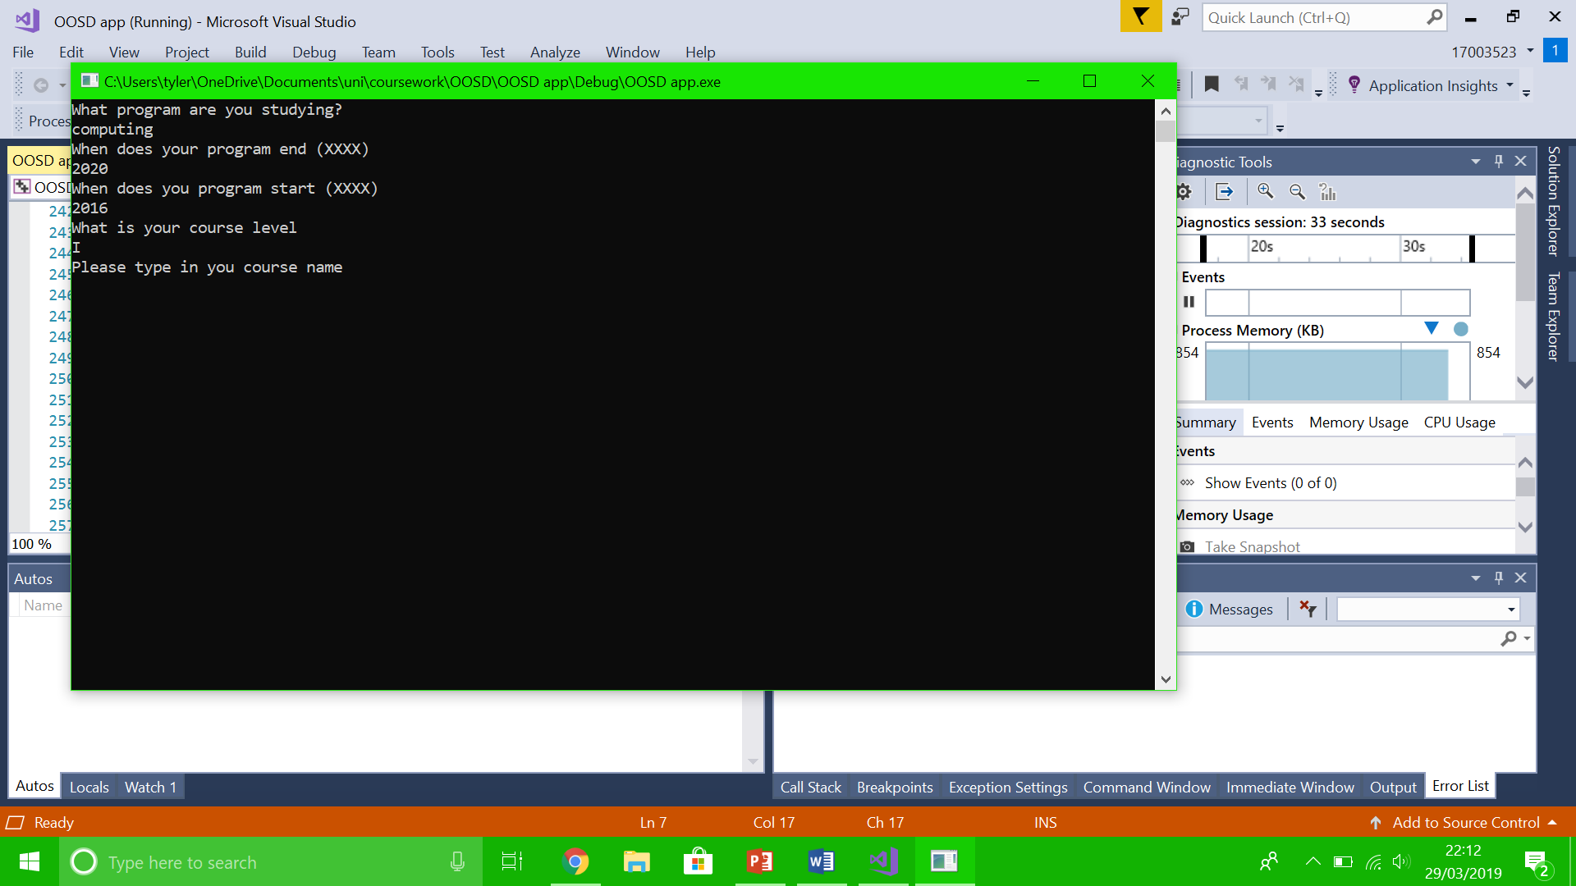
User is asked for :
Programme of study
Start and end date
Course level and name
Assessments on course
Numeric grade
Assessment weighting

Slide 6
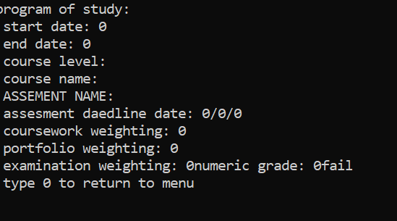
Student details are displayed in the format shown on the right
User is automatically graded based on their numeric grade

Slide 7
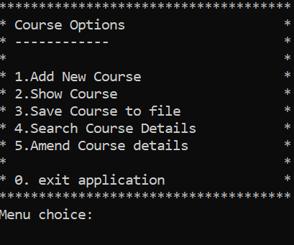

Course menu
Add course details
View course details
This Photo by Unknown Author is licensed under CC BY-SA

Slide 8
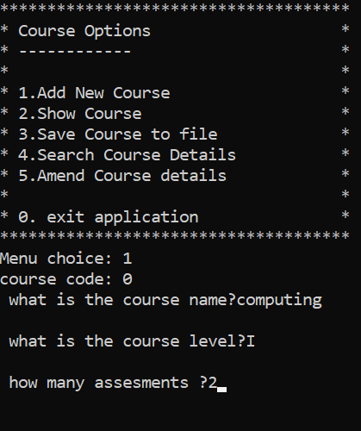
Course code is automatically assigned
User is asked for :
Course name
Course level
Number of assesments

Slide 9
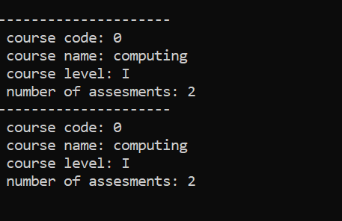
course details are displayed in the format shown on the right
An array of course details can be displayed

Slide 10
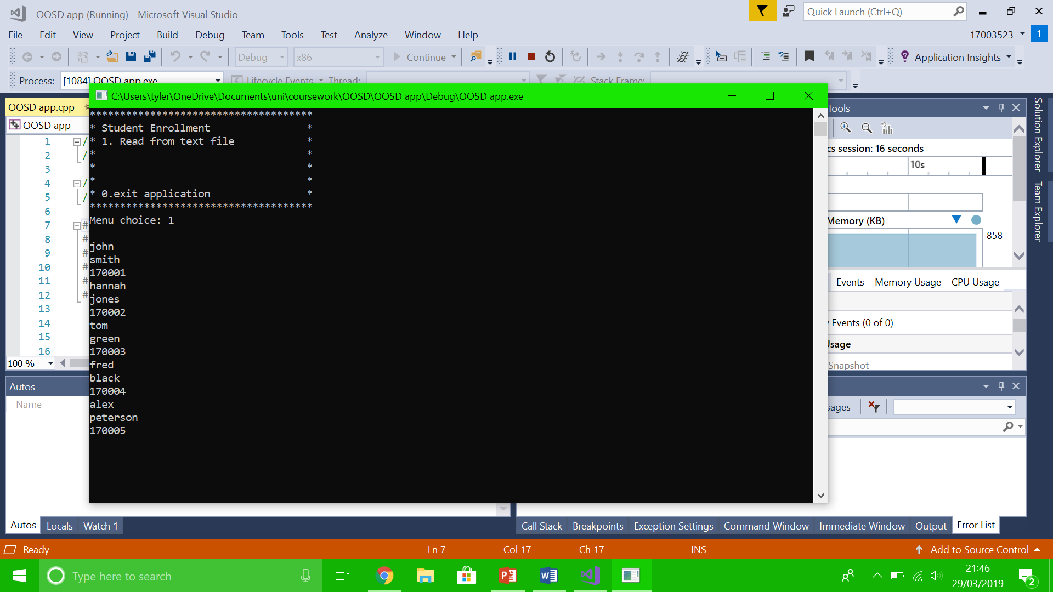
Enroll student
Read names and student numbers from a text file
This Photo by Unknown Author is licensed under CC BY-SA

Slide 11

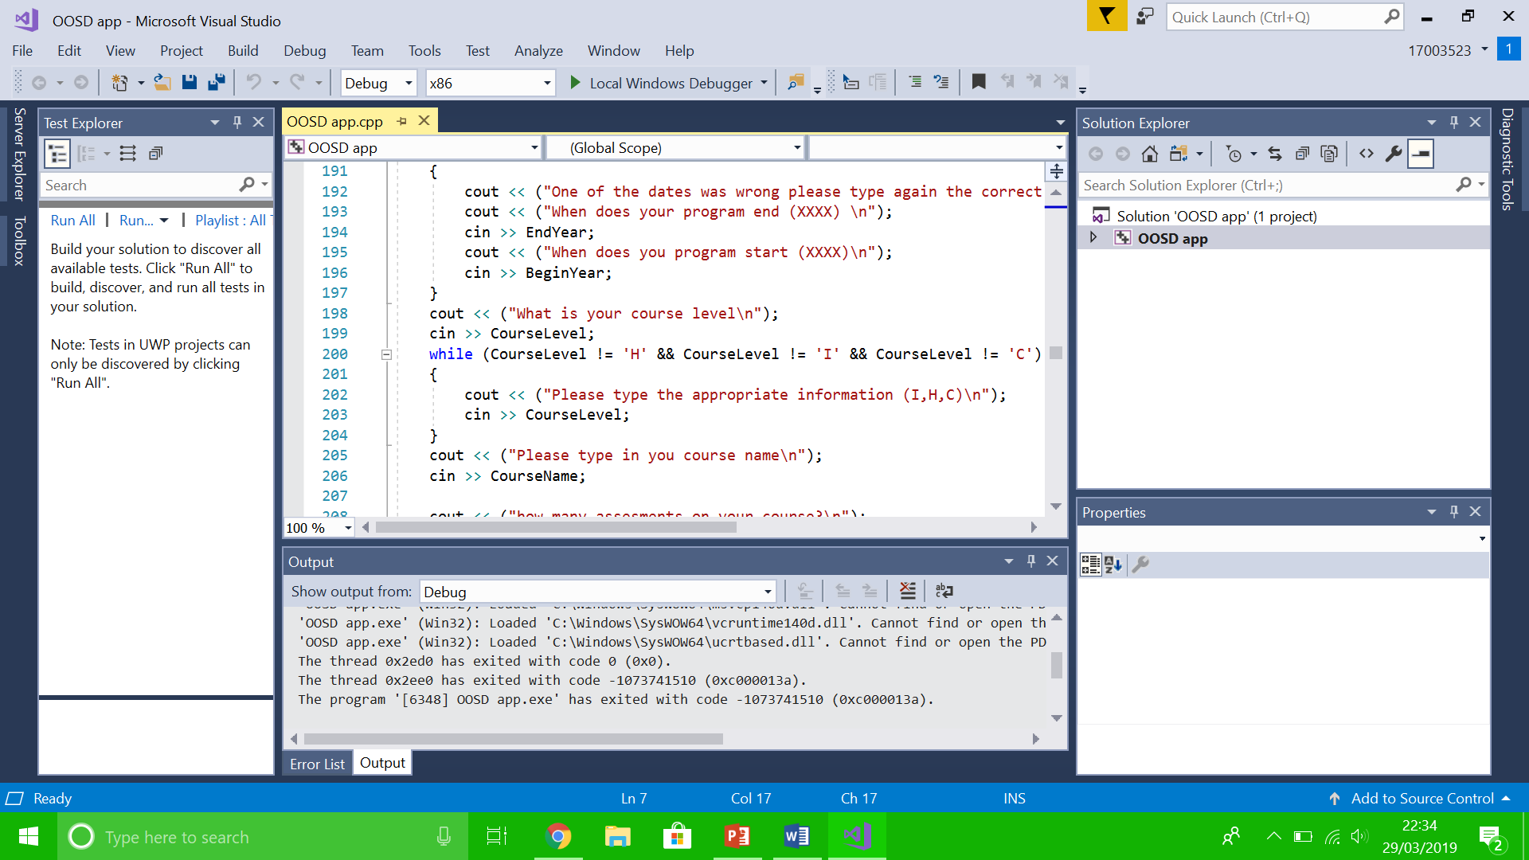
Avoiding errors
Contingencies are in place to ensure there are no errors
The example on the left keeps asking the user to type either H, I or C until the correct input is provided

